Slide 1
3- GAN Evaluations
Risman Adnan Mattotorang
Software R&D Director
Samsung R&D Institute Indonesia

Slide 2
Welcome to Data Science Center UI
What You Will Learn Today
Problems in Evaluating Generative Models
Common Techniques to Evaluate GANs
Implementation of Inception Score
Implementation of and Frechet Inception Distance
What You Will Practice Today
Setup Your GAN experiments (Collab, PyTorch)
Use IS and FID to evaluate GANs

Slide 3
Key Question in Evaluating GANs
Evaluating GANs is very tricky
Different metrics can lead to different trade-offs
Different evaluations favor different models
Key question: What is the task that you care about?
Density Estimation
Sampling/Generation
Latent Representation Learning
More than one task? E.g., Semisupervised learning, image translation, etc.
Evaluation drives progress, but how do we evaluate generative models?
An evaluation based on samples is biased towards models which overfit and therefore a poor indicator of a good density model in a log-likelihood sense, which favors models with large entropy. Conversely, a high likelihood does not guarantee visually pleasing samples. Samples can take on arbitrary form only a few bits from the optimum.

Slide 4
Problems in Evaluating GAN Samples
Lets take evaluation of generated image quality for example.
Visual quality of images is a highly subjective thing. No single definitive solution to formulize it.
We need to have more or less reliable function to evaluate GANs generated images.
Q: How to formulate such evaluation function systematically?
A: Apply statistic or information theory for saliency and diversity.
Saliency vs Diversity
Saliency (what is the object) is a distribution of classes for any individual image should have low entropy. One can think of it as a single high score and the rest very low.
Diversity (how different with other objects) is overall distribution of classes across the sampled data should have high entropy, which would mean the absence of dominating classes and something closer to a well-balanced training set.

Slide 5
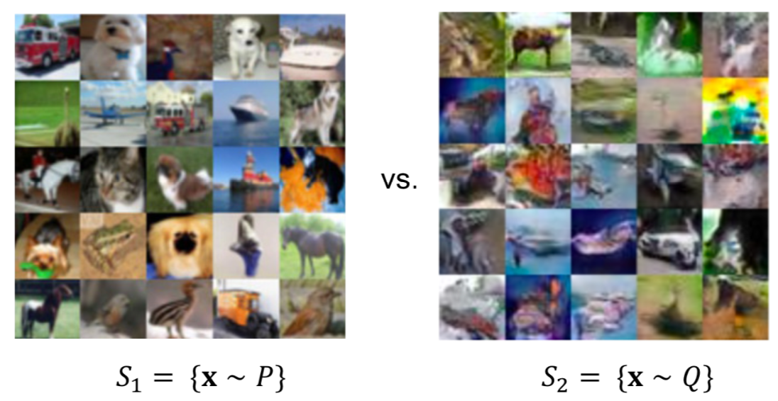
GAN Evaluation – Quality of Generation
Which set “look” better?
Human inspection are expensive, biased, hard to reproduce.
Generalization is hard to define and assess: memorizing the training set would give excellent samples but clearly undesirable
Quantitative evaluation of a qualitative task can have many answers
Popular Metrics: Inception Scores (IS), Frechet Inception Distance (FID), Kernel Inception Distance (KID)

Slide 6
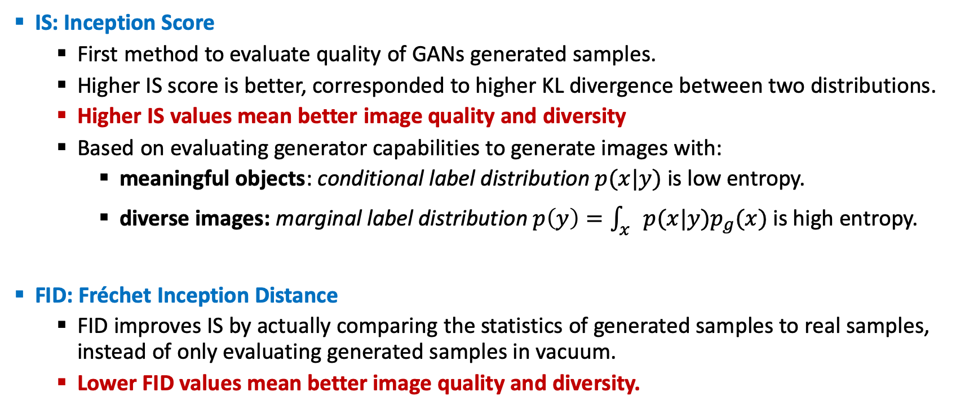
Common GAN Evaluation Techniques
IS: Inception Score
First method to evaluate quality of GANs generated samples.
Higher IS score is better, corresponded to higher KL divergence between two distributions.
Higher IS values mean better image quality and diversity
Based on evaluating generator capabilities to generate images with:
meaningful objects: conditional label distribution $p(x|y)$ is low entropy.
diverse images: marginal label distribution $p\left(y\right)=\int_{x}{p(x|y)p_{g}(x)}$is high entropy.
FID: Fréchet Inception Distance
FID improves IS by actually comparing the statistics of generated samples to real samples, instead of only evaluating generated samples in vacuum.
Lower FID values mean better image quality and diversity.

Slide 7

IS vs FID Definitions
IS is very intuitive formula based on KL-Divergence. KL-Divergence is a measure of information loss occurring when instead of a true empiric distribution an approximation is used.
Note: Implementation is straight forward and shown in sample codes.
FID uses inception network to extract features from an intermediate layer. Then it models the data distribution of those features using a multivariate Gaussian distribution with mean µ and covariance Σ.
Note: FID as it is more robust to noise and sensitive to mode collapse compare to IS.

Slide 8
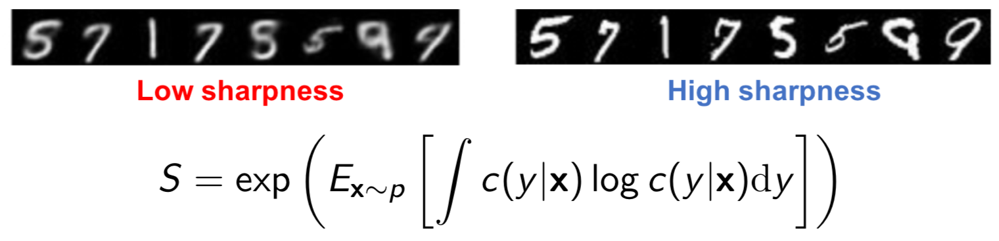
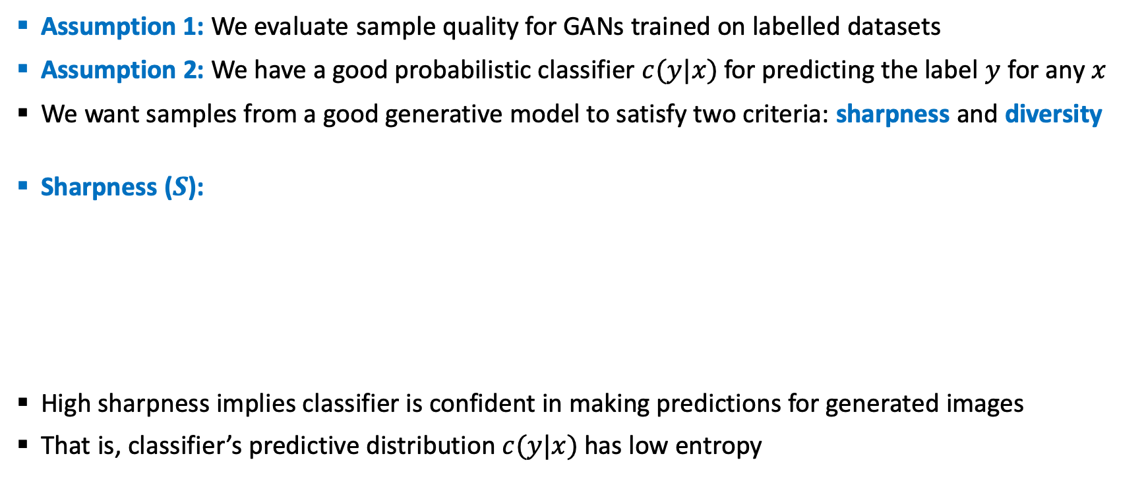
Inception Score Explained
Assumption 1: We evaluate sample quality for GANs trained on labelled datasets
Assumption 2: We have a good probabilistic classifier $c(y|x)$ for predicting the label $y$ for any $x$
We want samples from a good generative model to satisfy two criteria: sharpness and diversity
Sharpness ($S$):
High sharpness implies classifier is confident in making predictions for generated images
That is, classifier’s predictive distribution $c(y|x)$ has low entropy

Slide 9
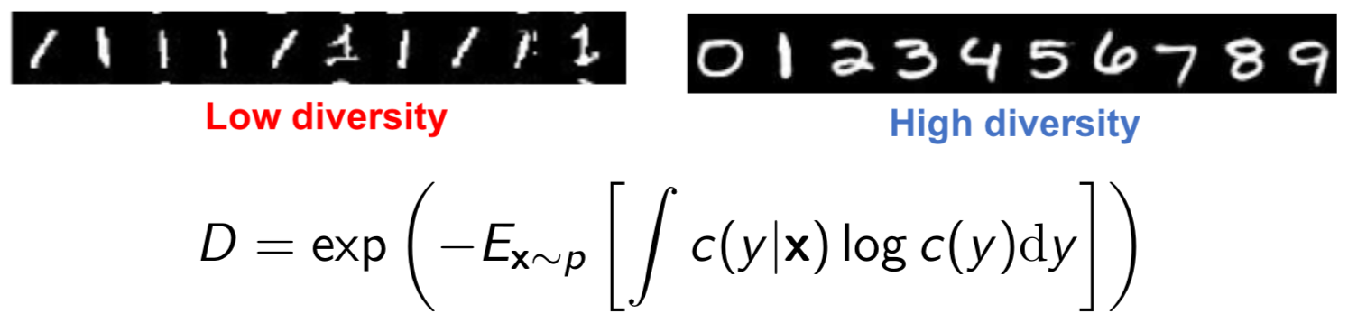
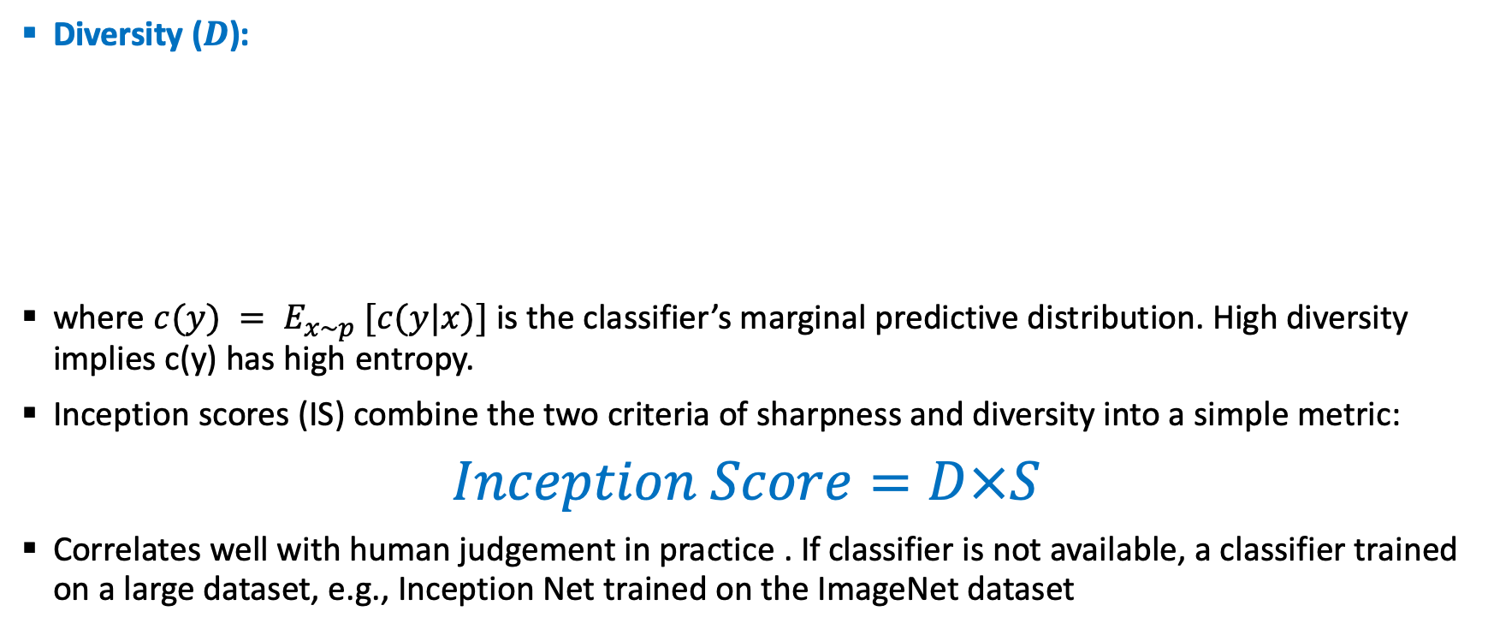
Inception Score Explained
Diversity ($D$):
where $c(y) = E_{x\sim p} [c(y|x)]$ is the classifier’s marginal predictive distribution. High diversity implies c(y) has high entropy.
Inception scores (IS) combine the two criteria of sharpness and diversity into a simple metric:
$Inception Score=D×S$
Correlates well with human judgement in practice . If classifier is not available, a classifier trained on a large dataset, e.g., Inception Net trained on the ImageNet dataset

Slide 10
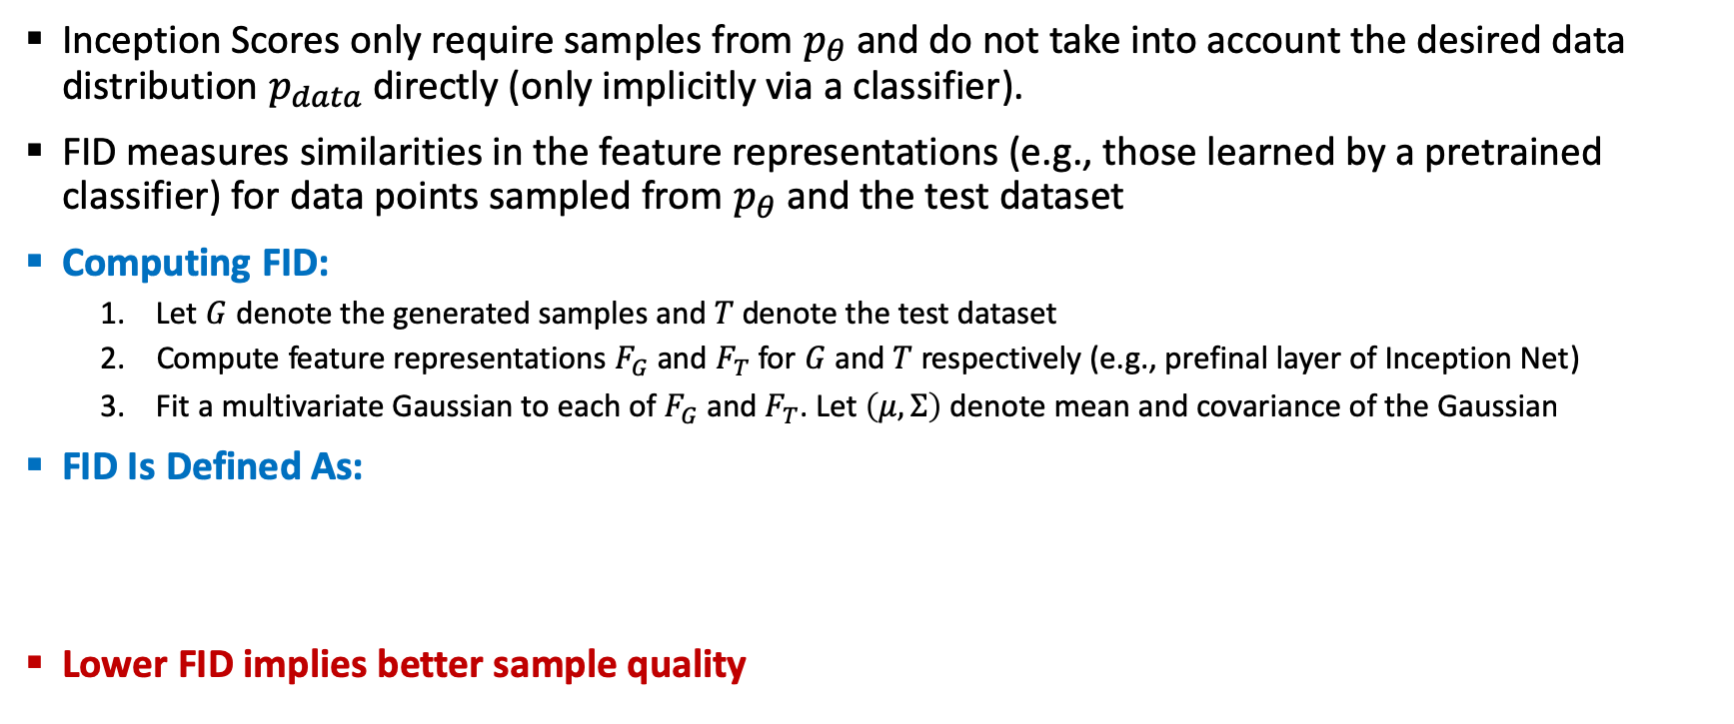
Frechet Inception Distance Explained
Inception Scores only require samples from $p_{θ}$ and do not take into account the desired data distribution $p_{data}$ directly (only implicitly via a classifier).
FID measures similarities in the feature representations (e.g., those learned by a pretrained classifier) for data points sampled from $p_{θ}$ and the test dataset
Computing FID:
Let $G$ denote the generated samples and $T$ denote the test dataset
Compute feature representations $F_{G}$ and $F_{T}$ for $G$ and $T$ respectively (e.g., prefinal layer of Inception Net)
Fit a multivariate Gaussian to each of $F_{G}$ and $F_{T}$. Let $\left(μ,Σ\right)$ denote mean and covariance of the Gaussian
FID Is Defined As:
Lower FID implies better sample quality

Slide 11
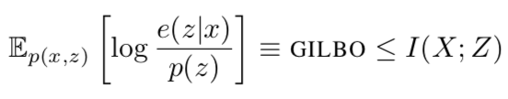
GILBO: Generative Information Lower Bound
GILBO: Simple, tractable lower bound of mutual information contained in the joint generative density of any latent variable generative model. A symmetric, non-negative, reparameterization independent measure of the information shared between two random variables is given by the mutual information:
GILBO offers data independent measure of the complexity of the learned latent variable description, giving the log of the effective descriptive length. The GILBO is entirely independent of true data, being a purely a function of the generative joint distribution.
GILBO gives different information than is currently available in FID as well as being able to distinguish between GANs with same FID scores.

Slide 12
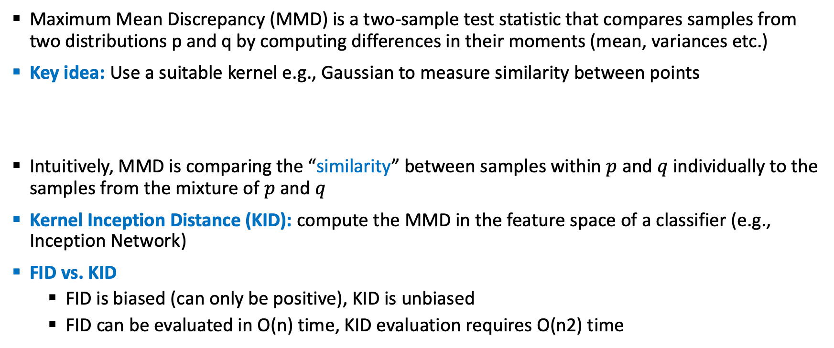
KID Kernel Inception Distance
Maximum Mean Discrepancy (MMD) is a two-sample test statistic that compares samples from two distributions p and q by computing differences in their moments (mean, variances etc.)
Key idea: Use a suitable kernel e.g., Gaussian to measure similarity between points
Intuitively, MMD is comparing the “similarity” between samples within $p$ and $q$ individually to the samples from the mixture of $p$ and $q$
Kernel Inception Distance (KID): compute the MMD in the feature space of a classifier (e.g., Inception Network)
FID vs. KID
FID is biased (can only be positive), KID is unbiased
FID can be evaluated in O(n) time, KID evaluation requires O(n2) time

Slide 13
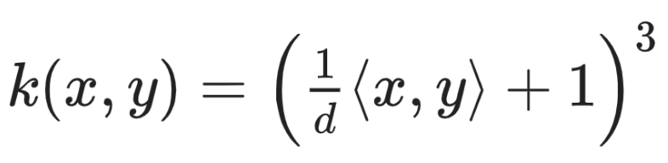
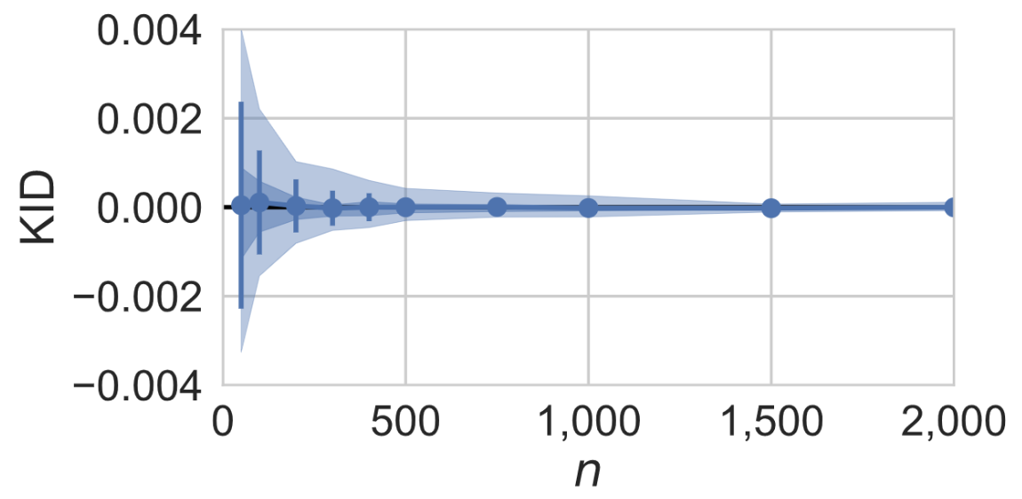
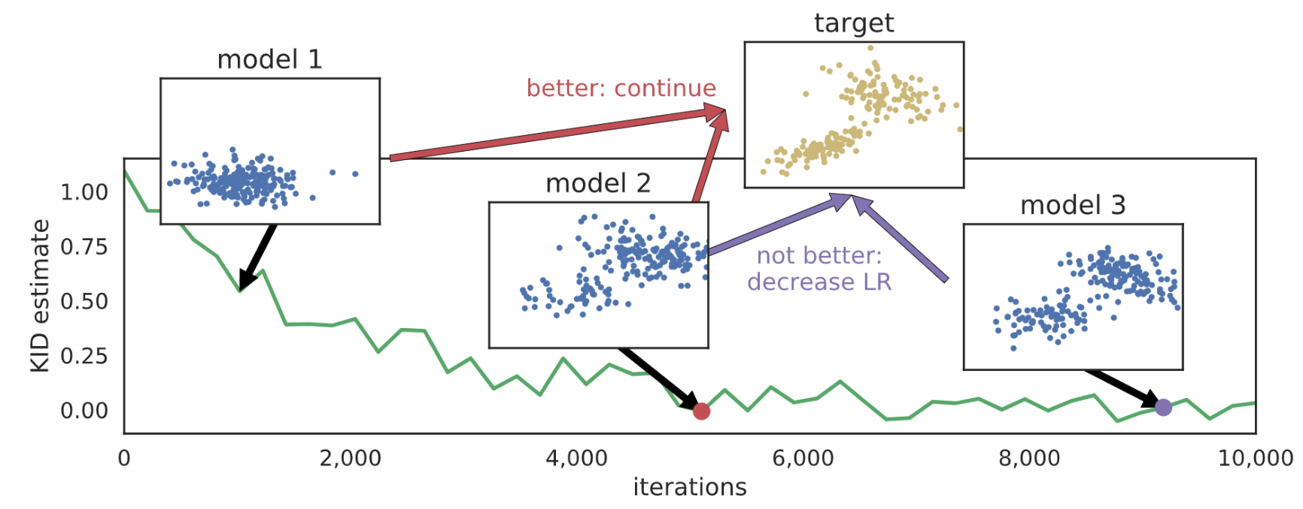
KID Kernel Inception Distance
FID is meaningful for not-ImageNet datasets. Estimator extremely biased. Tiny variance.
KID defined as MMD between inception hidden layer activations.
Use default polynomial kernel:
Unbiased estimator, reasonable with few samples.
KID can be used for automatic learning rate adaptation, eq. three sample MMD test.

Slide 14
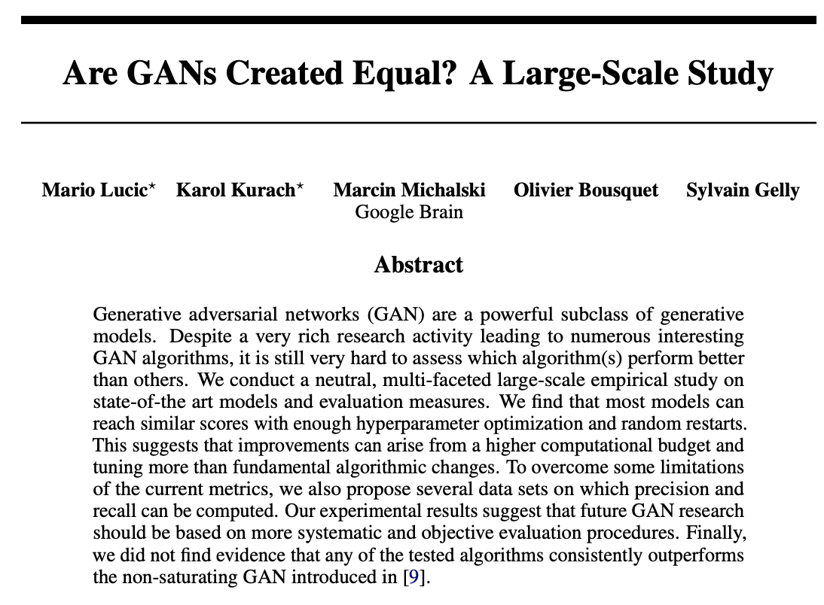
Best Practices on Evaluating Sample Quality
Spend time tuning your baselines (architecture, learning rate, optimizer etc.). Be amazed (rather than dejected) at how well they can perform
Use random seeds for reproducibility
Report results averaged over multiple random seeds along with confidence intervals

Slide 15
Selected Papers for Reading
A Note on Evaluation of Generative Models, ICLR 2016
Evaluation of Generative Networks Through Their Data Augmentation Capacity, ICLR 2018
A Note on Inception Score, ICLR 2018
An empirical study on evaluation metrics of generative adversarial networks, ICLR 2018
Pros and Cons of GAN Evaluation Measures, Arxiv 2018
GILBO: One Metric to Measure Them All, NIPS 2018
Geometry Score: A Method For Comparing Generative Adversarial Networks, ICML 2018

